Slide 1


Slide 2
Who
MENU
DATA
insights
task
Data ANALYSIS
Disney+ is an American subscription-based media streaming service.
what
Analyzing the streamed content with respect to time, place and preference
why
Hidden Insights and creating profitable content based on place, time

Slide 3
Data
Data Validation
Shape
02
01
Fields
03
MENU
DATA
insights
task
Data ANALYSIS
Date column – reformatting
Director column – missing values
Invalid data entries
8807 rows
12 columns
Type of the content: TV Show or a Movie
Title, Description
Content rating, Diffèrent genres,Country
Date Added: The date the content was added to Disney+

Slide 4
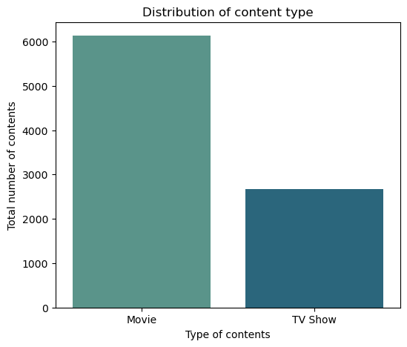
Interesting insights
MENU
DATA
insights
Data ANALYSIS
70%
Movies
30%
TV shows

Slide 5
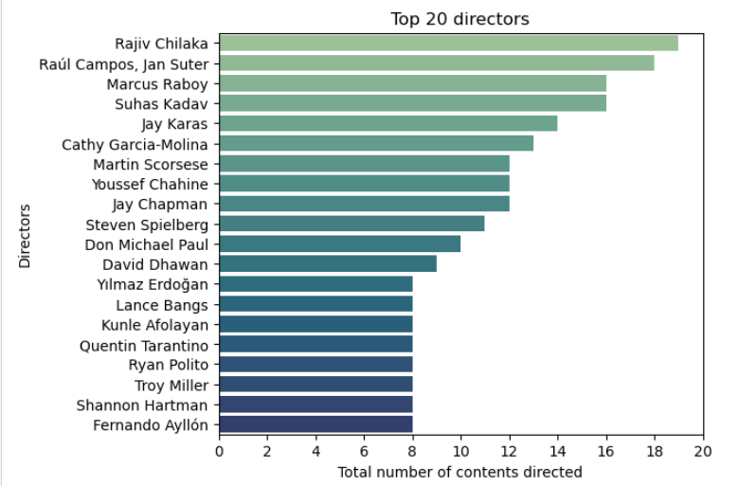
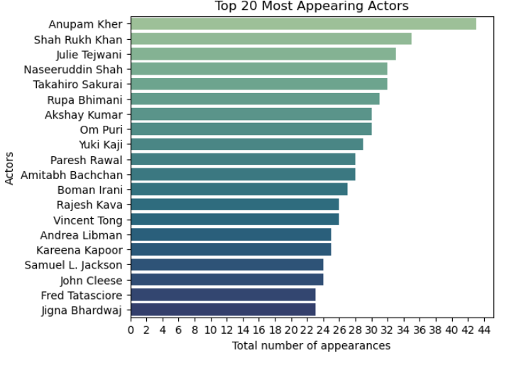
TOP DIRECTORS AND ACTORS
MENU
DATA
insights
Data ANALYSIS

Slide 6
OF Contents Geographically
01
MENU
1
2
3
4
5
Data ANALYSIS
Distribution

Slide 7
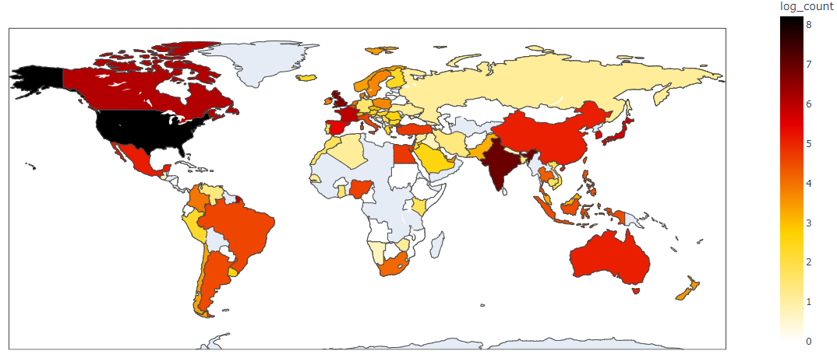
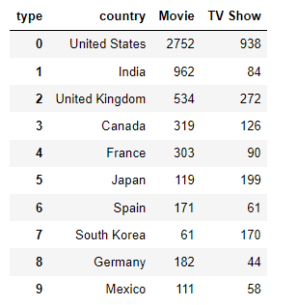
MENU
1
2
3
4
5
Data ANALYSIS

Slide 8
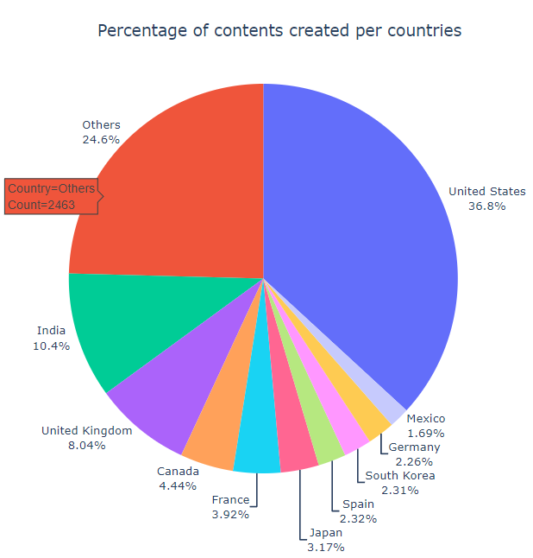
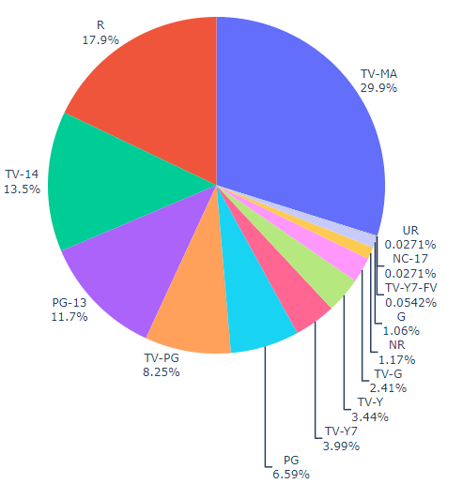
MENU
1
2
3
4
5
Data ANALYSIS

Slide 9
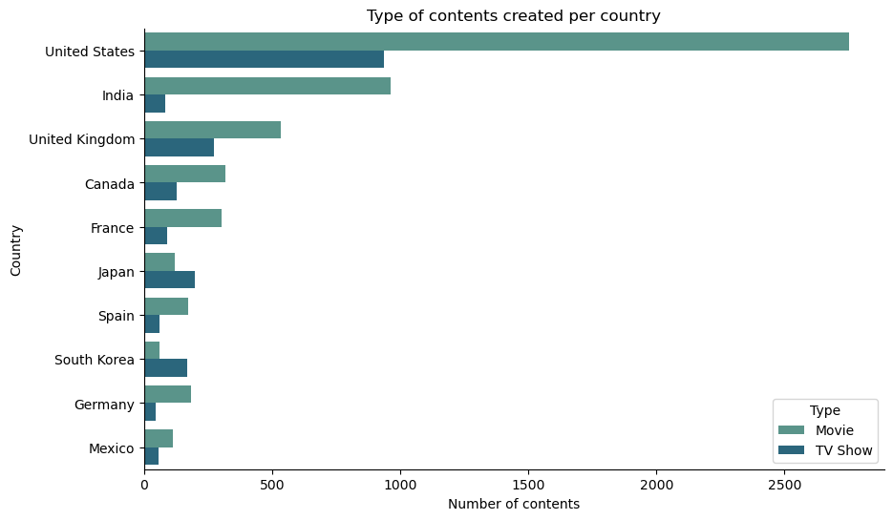
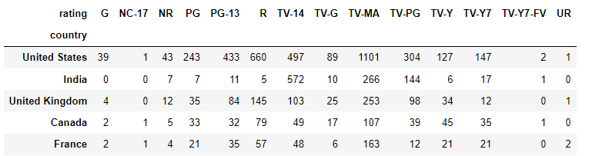
MENU
1
2
3
4
5
Data ANALYSIS

Slide 10
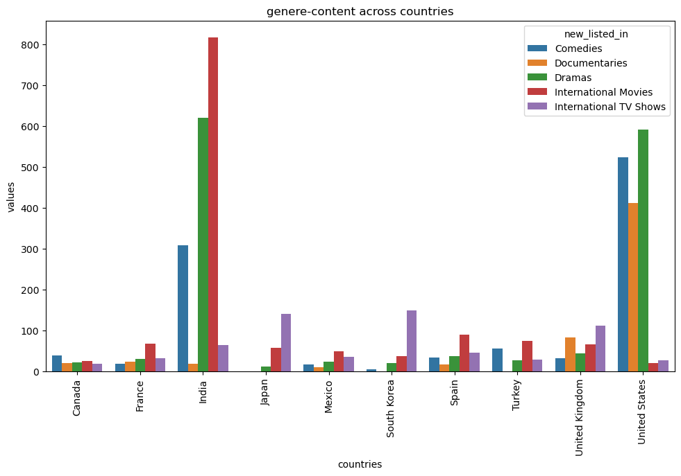
MENU
1
2
3
4
5

Slide 11
OF Contents Over Time
02
MENU
1
2
3
4
5
Data ANALYSIS
Types

Slide 12
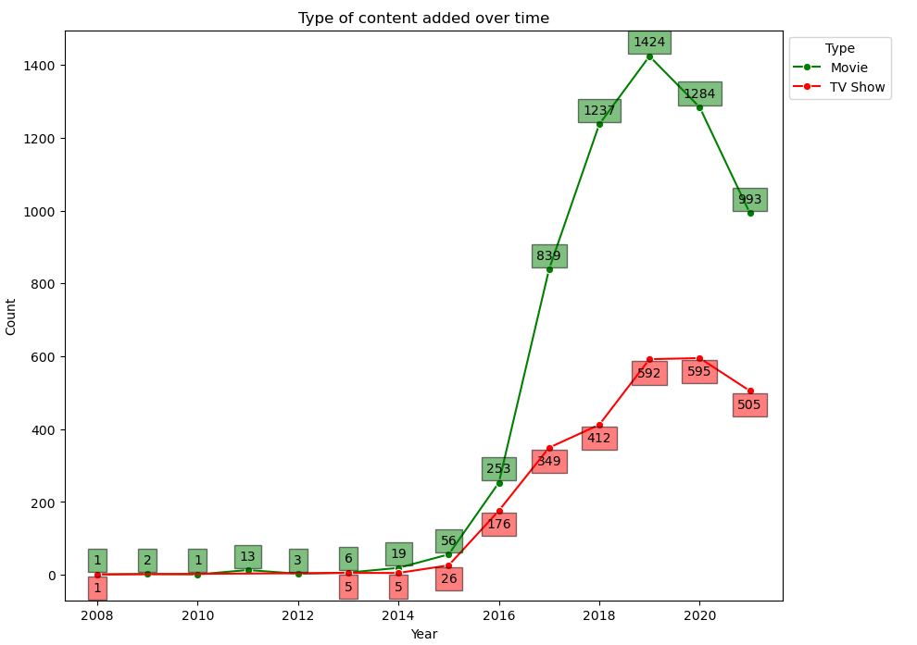
MENU
1
2
3
4
5
Data ANALYSIS
Steady rise in contents being added.
2015
2008
2019
Initial contents added on Disney+.
Dip in the contents being added.

Slide 13
words in The Contents
03
MENU
1
2
3
4
5
Data ANALYSIS
Recurring

Slide 14
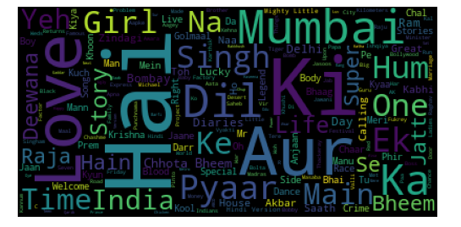
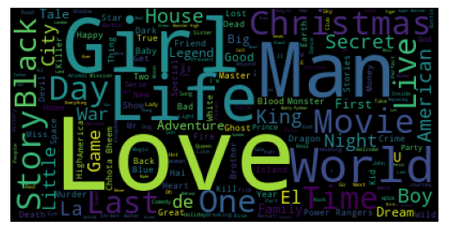
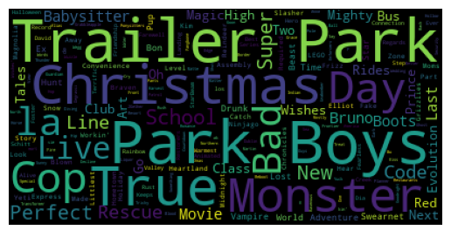
LOVE is universal
MENU
1
2
3
4
5
Data ANALYSIS
overall
india
canada

Slide 15
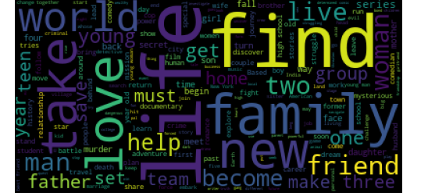
MENU
1
2
3
4
5
Data ANALYSIS
Most of the content has "Love" in the Title
Description as well it has more words like "love", "young", "life,” "world,” and “friends," creating a more sense of the movie plot
CONTENT description
United States | - "Christmas" and "American" in titles - Plots words like "new", "life", and "world"
Canada | - "Trailer", "Christmas,” and "monsters" in titles - Plots often described using "friends"
India | - In titles "love" and similar words - Plots biased towards male actors, with the word "man" repeated frequently
Notes:
Title: most of the shows or content has "Love" --> universal language , "2" --> signifies the part of various shows (recent trend in the decade)
Decription: in description as well it has more words like "love", "young", "life", "world", "freinds" createing a more sense on the movie plots
The US is obsessed with the words Christmas and American in the titles and the plots are described through words like new, life and world
India is using their origin languages in the title with love similar words in different synonyms are present and the mumbai is used more often. Their plots are biased with preference to the male actors so the word man is kept repeating.
In Canada, Trailer, Christmas and monsters are repeated with friends to describe the pltos

Slide 16
OF Contents Over a year
04
MENU
1
2
3
4
5
Data ANALYSIS
Types

Slide 17
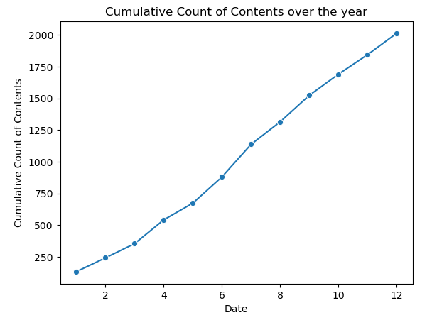
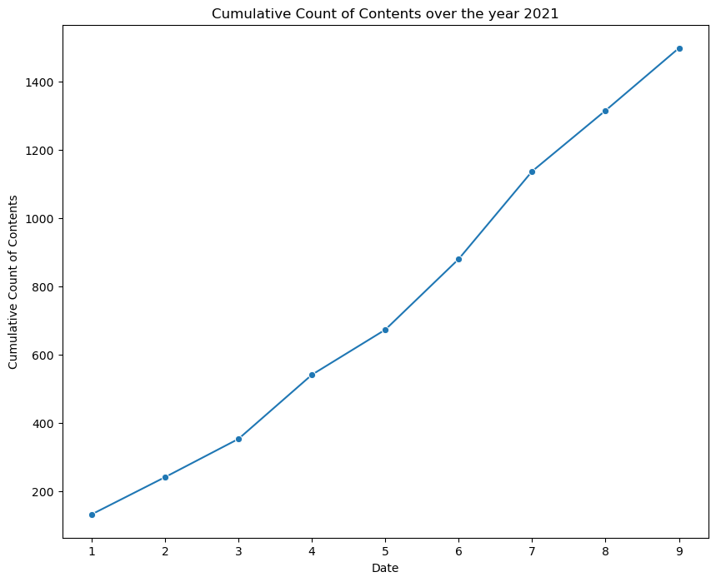
MENU
1
2
3
Data ANALYSIS

Slide 18
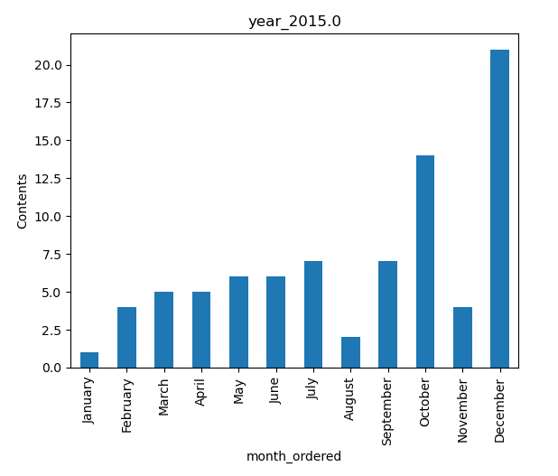
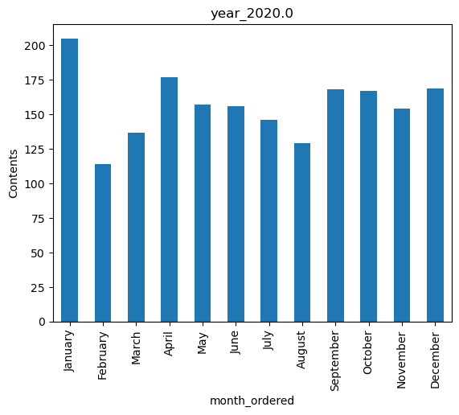
MENU
1
2
3
Data ANALYSIS

Slide 19
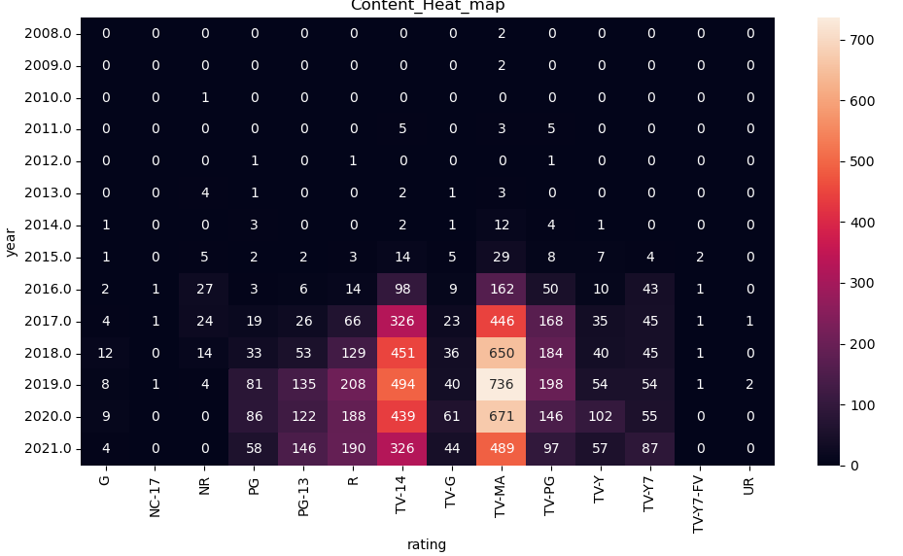
MENU
1
2
3
Data ANALYSIS

Slide 20
popular rating category
05
MENU
1
2
3
4
5
Data ANALYSIS
Most

Slide 21
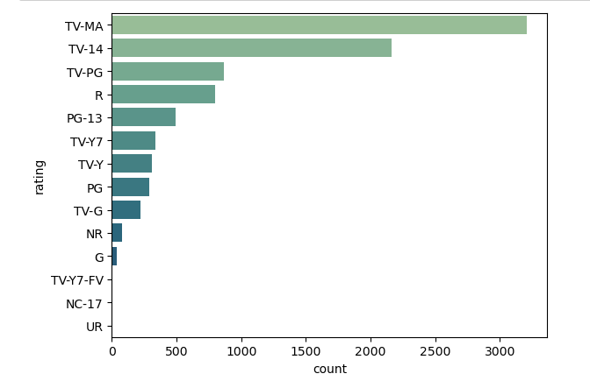
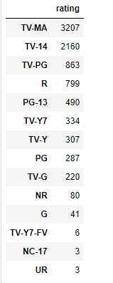
MENU
1
2
3
4
5
Data ANALYSIS

Slide 22

Aanal Patel, Bimal Shrestha, Danilo Diaz, Ernie Sumoso, Jayachandhran Saravanan
THANKS!
Class of winter …. Lambton…Toronto !!

Slide 23
rEFERENCES
MENU
Data ANALYSIS
Stream the greatest Movies, Series, Originals and more | Disney+ Canada. (n.d.). Disney+. https://www.disneyplus.com/en-ca
https://www.pexels.com/photo/person-holding-black-remote-control-3721597/
https://www.pexels.com/photo/selective-focus-photo-of-man-s-index-finger-3779434/
https://slidesgo.com/faqs
DataFrame — pandas 2.2.2 documentation. (n.d.). https://pandas.pydata.org/docs/reference/frame.html
Python API reference for plotly — 5.21.0 documentation. (n.d.). https://plotly.com/python-api-reference/
seaborn: statistical data visualization — seaborn 0.13.2 documentation. (n.d.). https://seaborn.pydata.org/
Matplotlib documentation — Matplotlib 3.8.4 documentation. (n.d.). https://matplotlib.org/stable/index.html
Whole working folder - https://mylambton-my.sharepoint.com/:f:/g/personal/c0910392_mylambton_ca/EkXo2J-rOutFro1vMVPyzBoBLGY75bo1E25Dn6eTmHpN9A?e=PvI7XB
Git hub - https://github.com/svjai/project_data_viz

